Slide 1
DEVELOP AN OUTCOME L2
Evidence of Learning Template
0154297679
Project Title: Dzung’s python sport quiz
Dzung

Slide 2
Github /Drive link
Trello board or PM link
https://trello.com/invite/b/jcg70ueh/c37163a9947422f76e2ad04d57cb3639/python-sport-quiz-evidence
You MUST provide evidence showing how the problem has been decomposed, how the components have been developed and trialled, and of how they have been assembled and tested to create a final, working outcome.

Slide 3
Project management: Setup
The project management tool I decided to use is trello. The project management can be found by clicking on the trello link in the previous slide and you will be able to find the cards I used to write down what I have been doing to manage the project. A project management technique that I used is ‘work breakdown structure’. This technique is planning the project and breaking down the project into smaller pieces to make it much easier to work on. I used this technique by dividing the project into smaller, simpler pieces and work on each piece slowly. This is done by me using the cards on trello. I write each crucial part of the project into different cards, then I break those cards into even smaller pieces in order to make it even simpler and less overwhelming to approach. This technique helps make the project easier and simpler to manage/approach. The version control tool that helped me with the project is the version that I used on MU Editor before I switched to using PyCharm. The version on MU Editor is a scratch version of the code, and the version used on PyCharm is a more advanced, and more worked on version. These 2 versions are on completely different files and completely different coding programmes. The version on MU Editor is the scratch/base version with no features, whereas the version on PyCharm is a more edited, added with advanced features and it is also user tested to ensure that any bugs have been fixed.

Slide 4
Why Trello and PyCharm was used.
I used Trello because it is easy and simple to use and it is the best in my opinion to use along with ‘work breakdown structure’. I also tried to use Monday.com but I felt like Trello was easier to use, and it’s simplicity fits my project more and the tools available on Trello fits my project much better. Trello also allowed me to collaborate with it anywhere on any device due to it being available on PC, ipad and even mobiles. Trello also has cards that breaks down the project into smaller pieces and that allows me to piece together what i have to do, slowly and more efficiently. It is also very simple which helps with not overwhelming and overcomplicating my project, which makes the process to so much easier to go through. I chose to use PyCharm because before PyCharm was used, I used MU Editor, MU Editor was working fine for the most part, however when i started to incorporate my advanced features, i found out that MU Editor doesn’t support one of the advanced features, which was sound. So then i made the switch to PyCharm. After switching to PyCharm, I found that it is really easy to use and that it supports my advanced features. It also has more features like version control system and other things which made the process of doing my project much easier. So i decided to to stick with PyCharm.

Slide 5
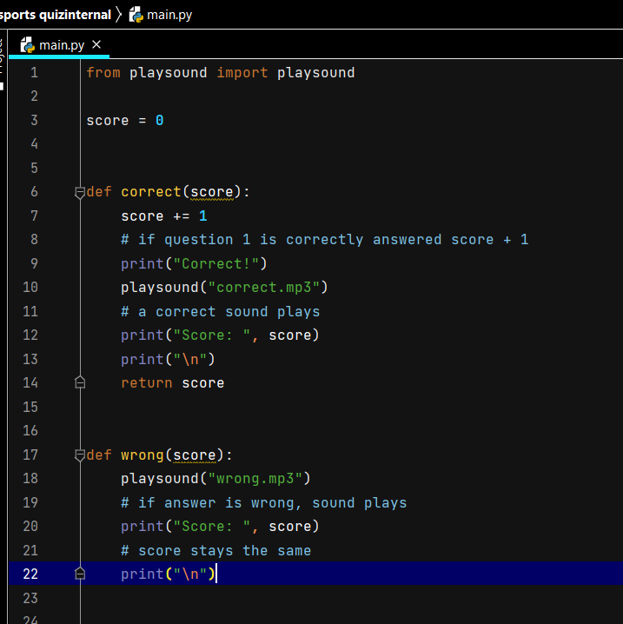
Decomposing outcome (start and defs)
This piece of code is the first part of the entire full code. Line 1: is an import of the function ‘playsound’ this function allows me to import mp3 files and allow sounds to be played whenever i want it to throughout the code. Line 3: defines the starting score that the user will start with, which is 0. From line 6 - 14 is the ‘def’ for when the user answers the question correctly. Line 6: is to define the function as “correct(score)”, by doing this it reduces the amount of repeated code throughout the entire code. This means that instead of typing repeated codes out, i only have to type ‘correct(score)’ and all the things defined in that def will function. Line 7: shows that by answering the question correct, they will gain a point from their current point at the previous part of the quiz. Line 9: prints out “Correct!” to show that the user answered correctly. Line 10: plays a sound that i have downloaded and imported. It is a “ding!” sound that indicates that the user got the question correct. Line 12: shows the score that the user currently has after answering the question correctly. Line 13: prints the next question. Line 14: wraps up def ‘correct(score)’. Line 17 - 22 is the ‘def’ for when the user answers the question incorrectly. Line 17: defines the def as ‘wrong(score)’. Same as ‘correct(score)’. For this def i only have to type out ‘wrong(score)’ and all the things defined in the def will function. Line 18: plays a sound that i have imported, it’s an intimidating sound to show that the user has answered incorrectly. Line 20: It prints the score that the user have, their score stays the same due to the wrong answer. Line 22: prints the next question. These defs help me reduce the amount of repeated codes by simply just using the 2 defs.

Slide 6
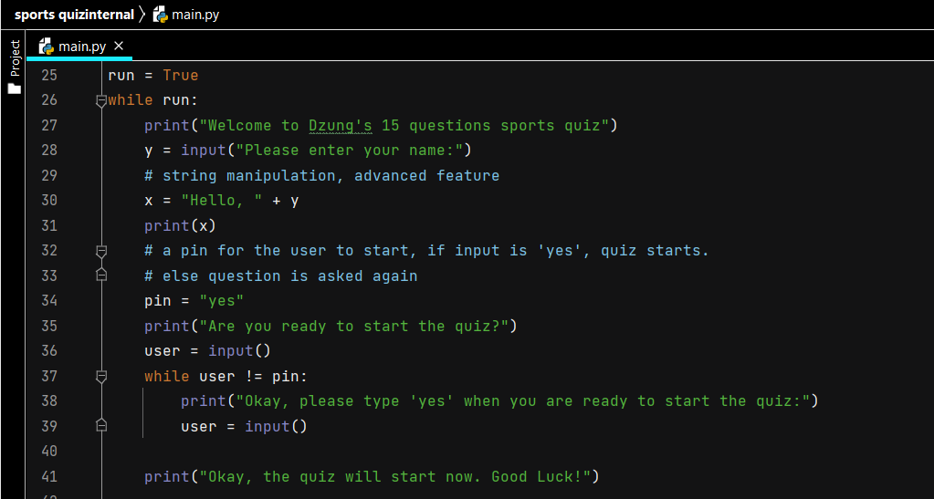
Decomposing outcome (welcome to quiz)
This part codes for welcoming user to the quiz. Line 25: defines run as true. Line 26: while run is true: everything below line 26 will function. Line 27: prints that message to welcome the user to my quiz. Line 28: string manipulation, defining ‘y’ as the user’s input for their name. Line 30: defines ‘x’ as “Hello, ” + y. Line 30: prints ‘x’, this means that it will print: “Hello, ‘y’ ” (y being whatever the user inputted for their name). Line 34: sets up a pin and the correct answer to that pin is “yes”. Line 35: asks user if they are ready to start the code. Line 36: allows user to input answer for question in Line 35. Line 37: a while loop. Line 38: if user inputs anything but “yes”, that message will print. Line 39: asks user to input pin again. Line 41: if the user inputs the correct pin which is: “yes”. That message will print and it will proceed to the quiz.

Slide 7
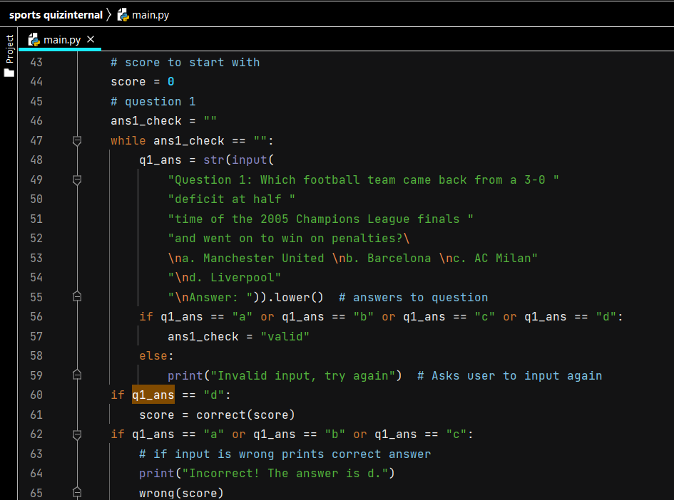
Decomposing outcome (question 1)
Line 44: defines the starting score as 0. Line 46 - 48: a string to check the validity of user’s input, close of string at line 55. Line 49 - 55: prints the question and answers available for question 1 and allows the user to input their answer. Line 56 - 57: a check to show that if the user inputs: “a”, “b”, “c” or “d”, then that input is valid. Line 58 - 59: if the user inputs anything other than the 4 given options that is “a”, “b”, “c” or “d”, then their input is invalid and they will be asked to input again until their input is valid. Line 60 - 61: if the user inputted “d”, then their input is correct and the def “correct(score)” will function. Line 62 - 65: if the user inputted: “a”, “b” or “c” then their input is wrong. The message prints, showing that the correct answer is “d”. And then def “wrong(score)” functions.

Slide 8
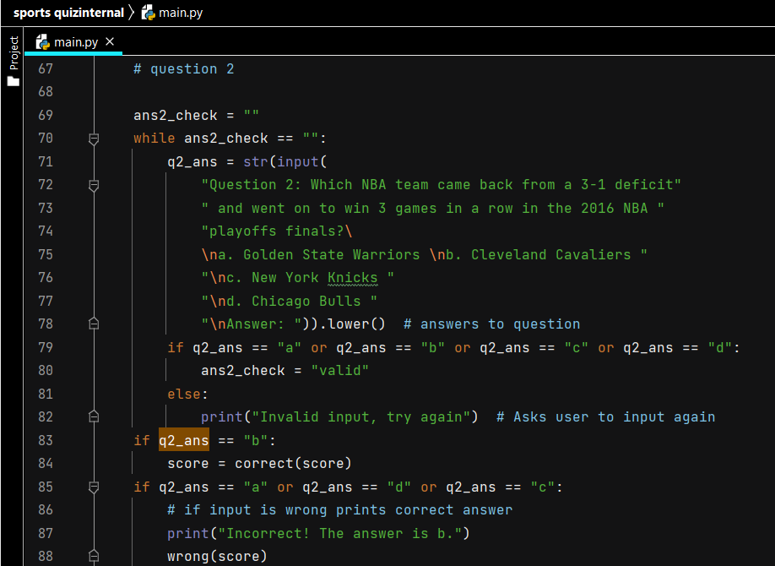
Decomposing outcome (question 2)
Line 69 - 71: a string to check the validity of user’s input, close of string at line 78. Line 72 - 78: prints the question and answers available for question 2 and allows the user to input their answer. Line 79 - 80: a check to show that if the user inputs: “a”, “b”, “c” or “d”, then that input is valid. Line 81 - 82: if the user inputs anything other than the 4 given options that is “a”, “b”, “c” or “d”, then their input is invalid and they will be asked to input again until their input is valid. Line 83 - 84: if the user inputted “b”, then their input is correct and the def “correct(score)” will function. Line 85 - 88: if the user inputted: “a”, “d” or “c” then their input is wrong. The message prints, showing that the correct answer is “b”. And then def “wrong(score)” functions.

Slide 9
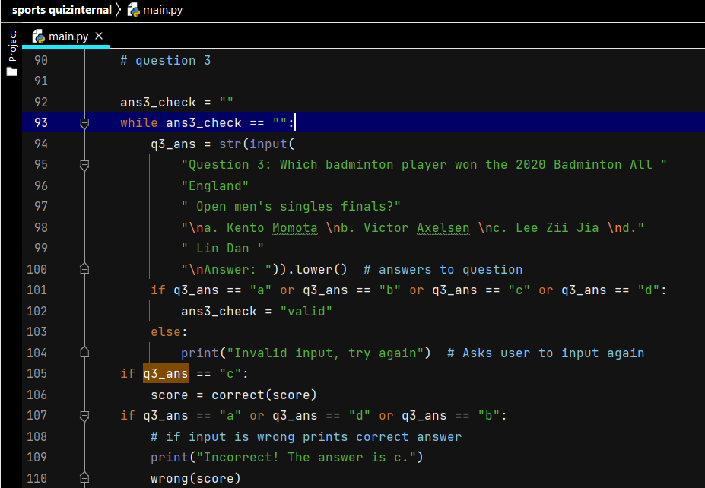
Decomposing outcome (question 3)
Line 93 - 94: a string to check the validity of user’s input, close of string at line 100. Line 95 - 100: prints the question and answers available for question 3 and allows the user to input their answer. Line 101- 102: a check to show that if the user inputs: “a”, “b”, “c” or “d”, then that input is valid. Line 103- 104: if the user inputs anything other than the 4 given options that is “a”, “b”, “c” or “d”, then their input is invalid and they will be asked to input again until their input is valid. Line 105 - 106: if the user inputted “c”, then their input is correct and the def “correct(score)” will function. Line 107 - 110: if the user inputted: “a”, “d” or “b” then their input is wrong. The message prints, showing that the correct answer is “c”. And then def “wrong(score)” functions.

Slide 10
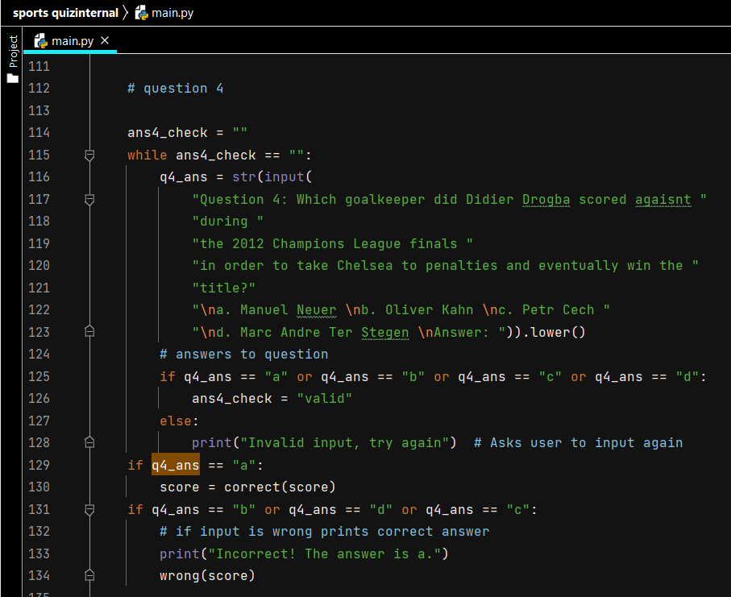
Decomposing outcome (question 4)
Line 114 - 116: a string to check the validity of user’s input, close of string at line 123. Line 117 - 123: prints the question and answers available for question 4 and allows the user to input their answer. Line 125 - 126: a check to show that if the user inputs: “a”, “b”, “c” or “d”, then that input is valid. Line 127 - 128: if the user inputs anything other than the 4 given options that is “a”, “b”, “c” or “d”, then their input is invalid and they will be asked to input again until their input is valid. Line 129 - 130: if the user inputted “a”, then their input is correct and the def “correct(score)” will function. Line 131 - 134: if the user inputted: “d”, “b” or “c” then their input is wrong. The message prints, showing that the correct answer is “a”. And then def “wrong(score)” functions.

Slide 11
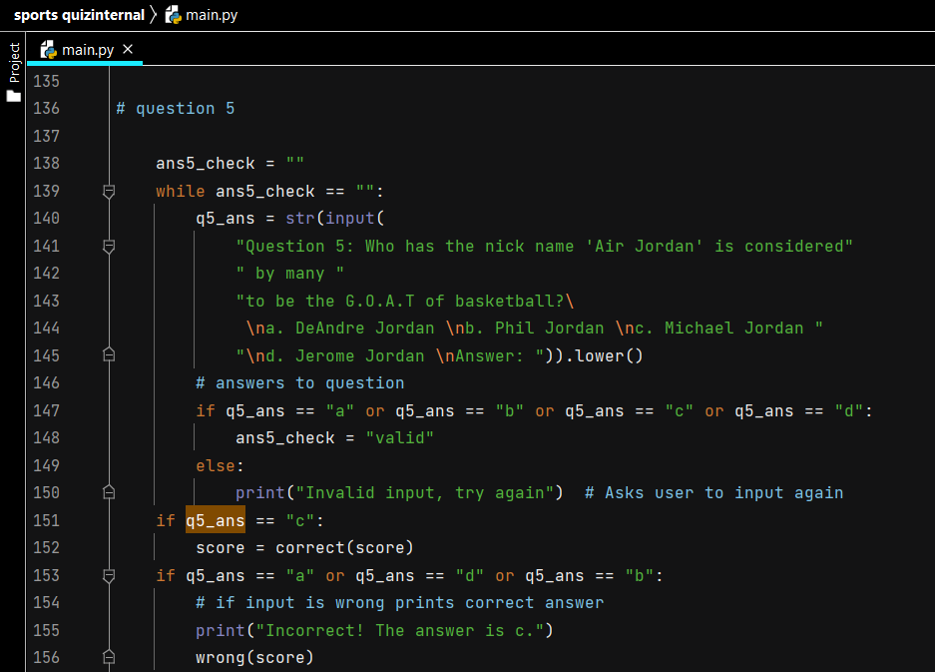
Decomposing outcome (question 5)
Line 138 - 140: a string to check the validity of user’s input, close of string at line 145. Line 141 - 145: prints the question and answers available for question 5 and allows the user to input their answer. Line 147 - 148: a check to show that if the user inputs: “a”, “b”, “c” or “d”, then that input is valid. Line 149 - 150: if the user inputs anything other than the 4 given options that is “a”, “b”, “c” or “d”, then their input is invalid and they will be asked to input again until their input is valid. Line 151 - 152: if the user inputted “c”, then their input is correct and the def “correct(score)” will function. Line 153 - 156: if the user inputted: “a”, “b” or “d” then their input is wrong. The message prints, showing that the correct answer is “c”. And then def “wrong(score)” functions.

Slide 12
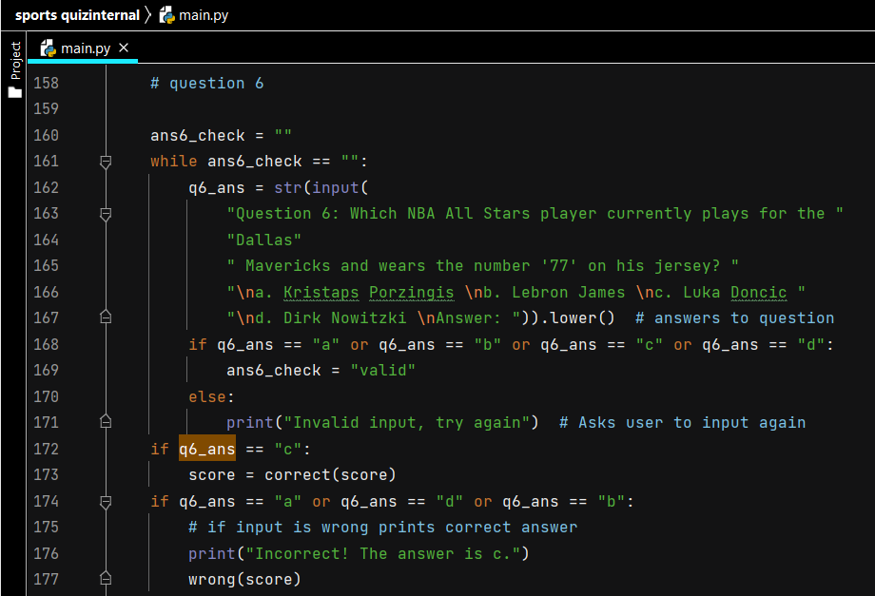
Decomposing outcome (question 6)
Line 160 - 162: a string to check the validity of user’s input, close of string at line 167. Line 163 - 167: prints the question and answers available for question 6 and allows the user to input their answer. Line 168 - 169: a check to show that if the user inputs: “a”, “b”, “c” or “d”, then that input is valid. Line 170 - 171: if the user inputs anything other than the 4 given options that is “a”, “b”, “c” or “d”, then their input is invalid and they will be asked to input again until their input is valid. Line 172 - 173: if the user inputted “c”, then their input is correct and the def “correct(score)” will function. Line 174 - 177: if the user inputted: “a”, “b” or “d” then their input is wrong. The message prints, showing that the correct answer is “c”. And then def “wrong(score)” functions.

Slide 13
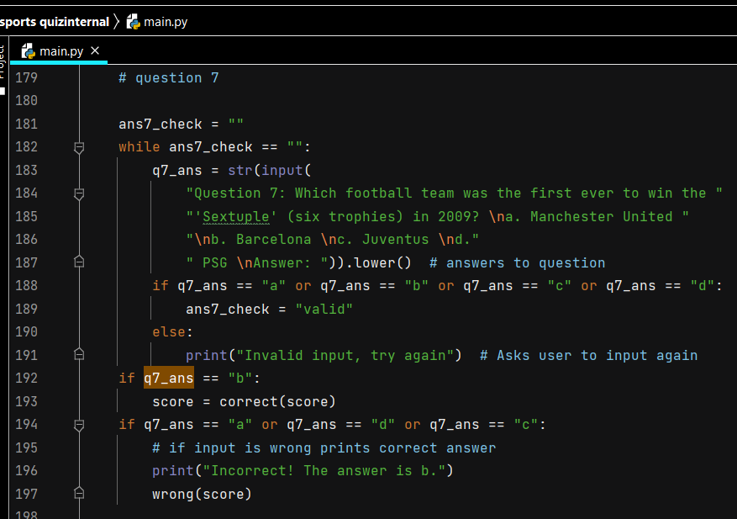
Decomposing outcome (question 7)
Line 181 - 183: a string to check the validity of user’s input, close of string at line 187. Line 184 - 187: prints the question and answers available for question 7 and allows the user to input their answer. Line 188 - 189: a check to show that if the user inputs: “a”, “b”, “c” or “d”, then that input is valid. Line 190 - 191: if the user inputs anything other than the 4 given options that is “a”, “b”, “c” or “d”, then their input is invalid and they will be asked to input again until their input is valid. Line 192 - 193: if the user inputted “b”, then their input is correct and the def “correct(score)” will function. Line 194- 197 if the user inputted: “a”, “d” or “c” then their input is wrong. The message prints, showing that the correct answer is “b”. And then def “wrong(score)” functions.

Slide 14
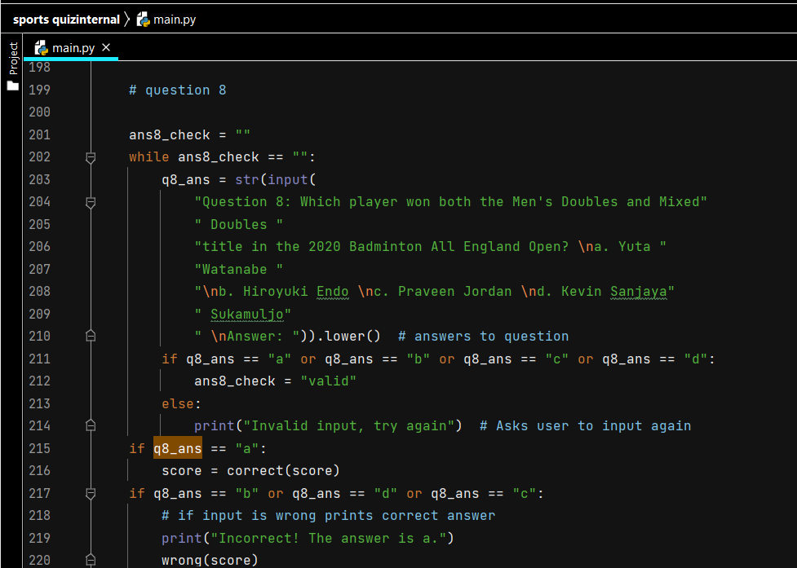
Decomposing outcome (question 8)
Line 201 - 203: a string to check the validity of user’s input, close of string at line 210. Line 204 - 210: prints the question and answers available for question 8 and allows the user to input their answer. Line 211 - 212: a check to show that if the user inputs: “a”, “b”, “c” or “d”, then that input is valid. Line 213 - 214: if the user inputs anything other than the 4 given options that is “a”, “b”, “c” or “d”, then their input is invalid and they will be asked to input again until their input is valid. Line 215 - 216: if the user inputted “a”, then their input is correct and the def “correct(score)” will function. Line 217 - 220: if the user inputted: “d”, “b” or “c” then their input is wrong. The message prints, showing that the correct answer is “a”. And then def “wrong(score)” functions.

Slide 15
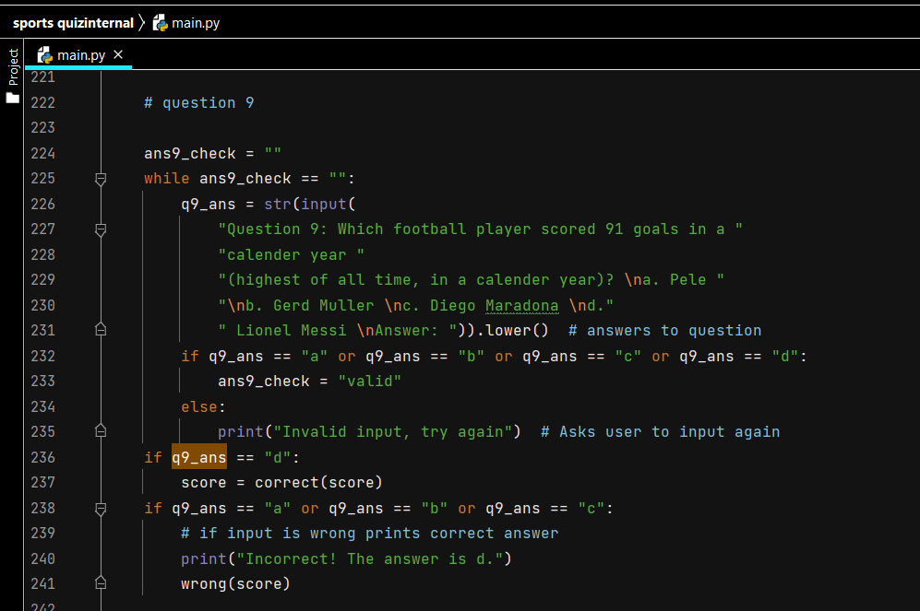
Decomposing outcome (question 9)
Line 224 - 226: a string to check the validity of user’s input, close of string at line 231. Line 227 - 231: prints the question and answers available for question 9 and allows the user to input their answer. Line 232 - 233: a check to show that if the user inputs: “a”, “b”, “c” or “d”, then that input is valid. Line 234 - 235: if the user inputs anything other than the 4 given options that is “a”, “b”, “c” or “d”, then their input is invalid and they will be asked to input again until their input is valid. Line 236 - 237: if the user inputted “d”, then their input is correct and the def “correct(score)” will function. Line 238 - 241: if the user inputted: “a”, “b” or “c” then their input is wrong. The message prints, showing that the correct answer is “d”. And then def “wrong(score)” functions.

Slide 16
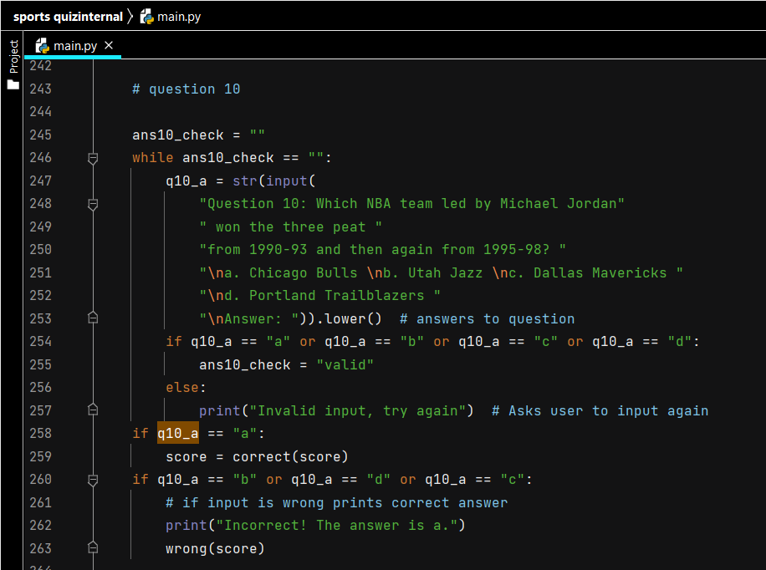
Decomposing outcome (question 10)
Line 245 - 247: a string to check the validity of user’s input, close of string at line 253. Line 248 - 253: prints the question and answers available for question 10 and allows the user to input their answer. Line 254 - 255: a check to show that if the user inputs: “a”, “b”, “c” or “d”, then that input is valid. Line 256 - 257: if the user inputs anything other than the 4 given options that is “a”, “b”, “c” or “d”, then their input is invalid and they will be asked to input again until their input is valid. Line 258 - 259: if the user inputted “a”, then their input is correct and the def “correct(score)” will function. Line 260 - 261: if the user inputted: “d”, “b” or “c” then their input is wrong. The message prints, showing that the correct answer is “a”. And then def “wrong(score)” functions.

Slide 17
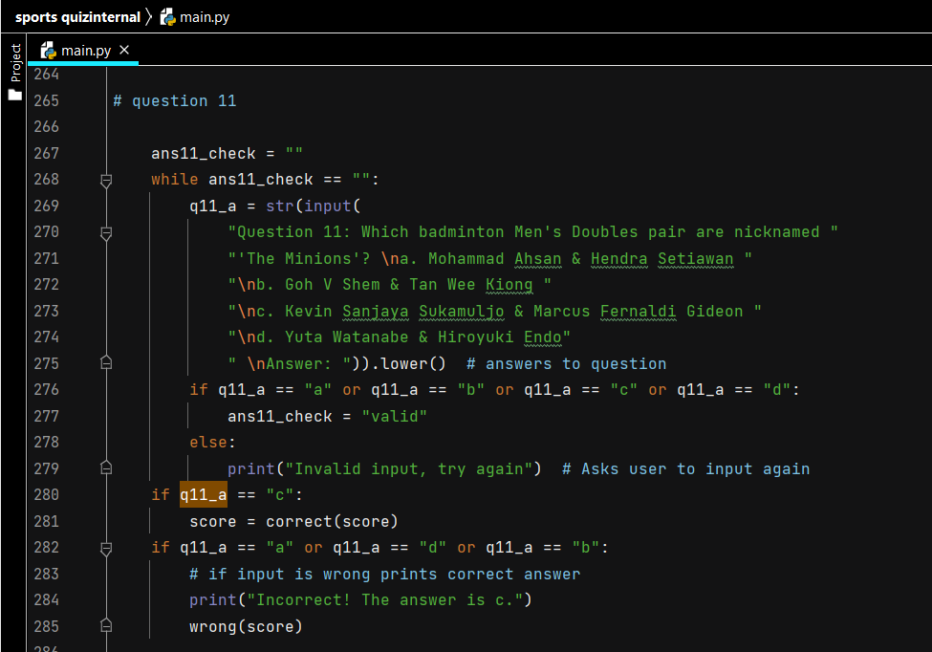
Decomposing outcome (question 11)
Line 267 - 269: a string to check the validity of user’s input, close of string at line 275. Line 270 - 275: prints the question and answers available for question 11 and allows the user to input their answer. Line 276 - 277: a check to show that if the user inputs: “a”, “b”, “c” or “d”, then that input is valid. Line 278 - 279: if the user inputs anything other than the 4 given options that is “a”, “b”, “c” or “d”, then their input is invalid and they will be asked to input again until their input is valid. Line 280 - 281: if the user inputted “c”, then their input is correct and the def “correct(score)” will function. Line 282 - 285: if the user inputted: “a”, “d” or “b” then their input is wrong. The message prints, showing that the correct answer is “c”. And then def “wrong(score)” functions.

Slide 18
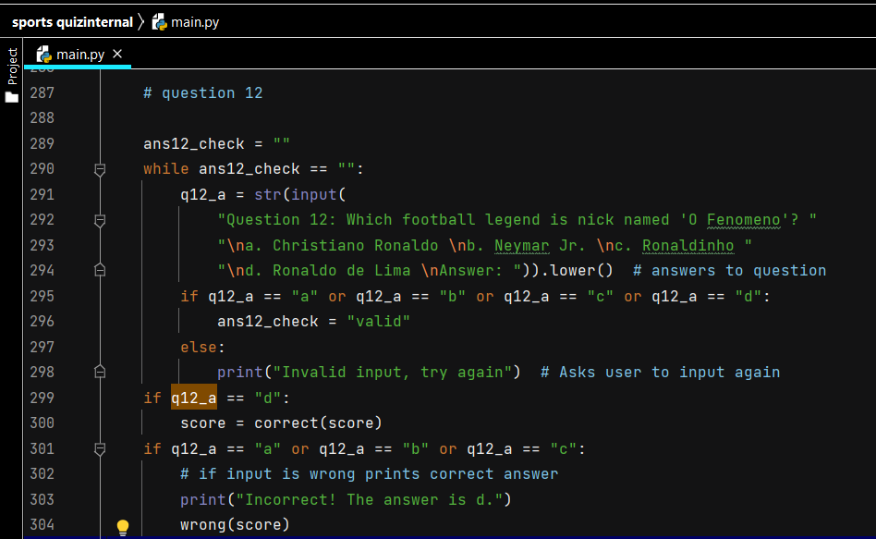
Decomposing outcome (question 12)
Line 289 - 291: a string to check the validity of user’s input, close of string at line 294. Line 292 - 294: prints the question and answers available for question 12 and allows the user to input their answer. Line 295 - 296: a check to show that if the user inputs: “a”, “b”, “c” or “d”, then that input is valid. Line 297 - 298: if the user inputs anything other than the 4 given options that is “a”, “b”, “c” or “d”, then their input is invalid and they will be asked to input again until their input is valid. Line 299 - 300: if the user inputted “d”, then their input is correct and the def “correct(score)” will function. Line 301 - 304: if the user inputted: “a”, “b” or “c” then their input is wrong. The message prints, showing that the correct answer is “d”. And then def “wrong(score)” functions.

Slide 19
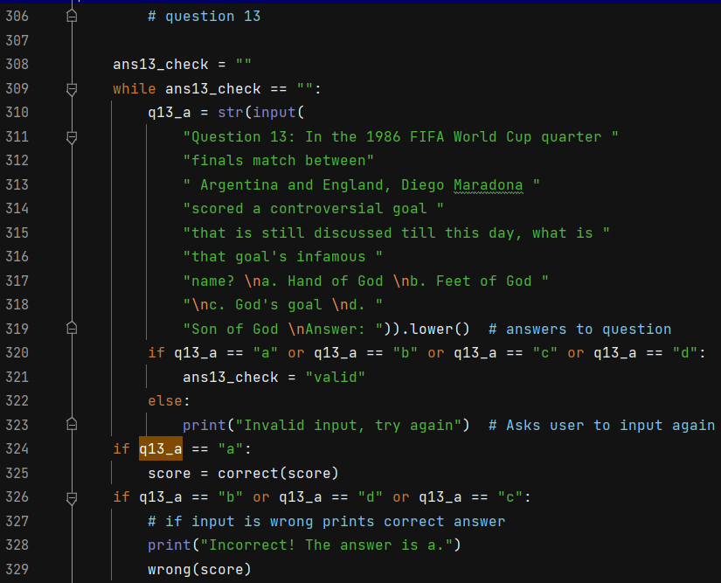
Decomposing outcome (question 13)
Line 308 - 310: a string to check the validity of user’s input, close of string at line 319. Line 311 - 319: prints the question and answers available for question 13 and allows the user to input their answer. Line 320 - 321: a check to show that if the user inputs: “a”, “b”, “c” or “d”, then that input is valid. Line 322 - 323: if the user inputs anything other than the 4 given options that is “a”, “b”, “c” or “d”, then their input is invalid and they will be asked to input again until their input is valid. Line 324 - 325: if the user inputted “a”, then their input is correct and the def “correct(score)” will function. Line 326 - 327: if the user inputted: “d”, “b” or “c” then their input is wrong. The message prints, showing that the correct answer is “a”. And then def “wrong(score)” functions.

Slide 20
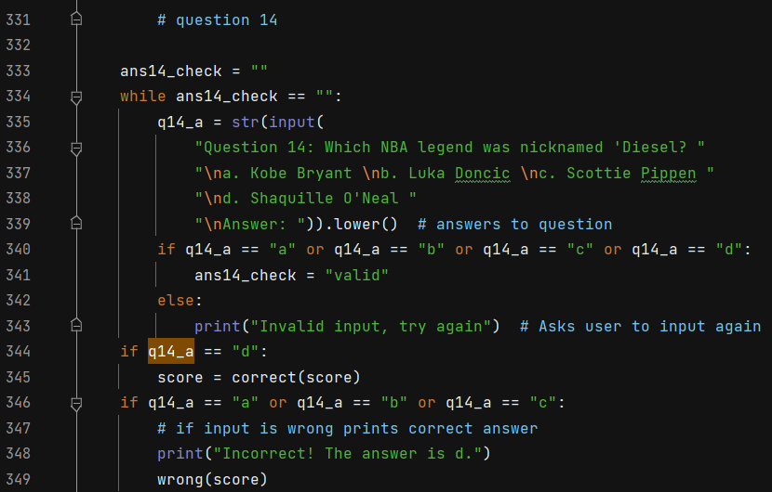
Decomposing outcome (question 14)
Line 333 - 335: a string to check the validity of user’s input, close of string at line 339. Line 336 - 339: prints the question and answers available for question 14 and allows the user to input their answer. Line 340 - 341: a check to show that if the user inputs: “a”, “b”, “c” or “d”, then that input is valid. Line 342 - 343: if the user inputs anything other than the 4 given options that is “a”, “b”, “c” or “d”, then their input is invalid and they will be asked to input again until their input is valid. Line 344 - 345: if the user inputted “d”, then their input is correct and the def “correct(score)” will function. Line 346 - 349: if the user inputted: “a”, “b” or “c” then their input is wrong. The message prints, showing that the correct answer is “d”. And then def “wrong(score)” functions.

Slide 21
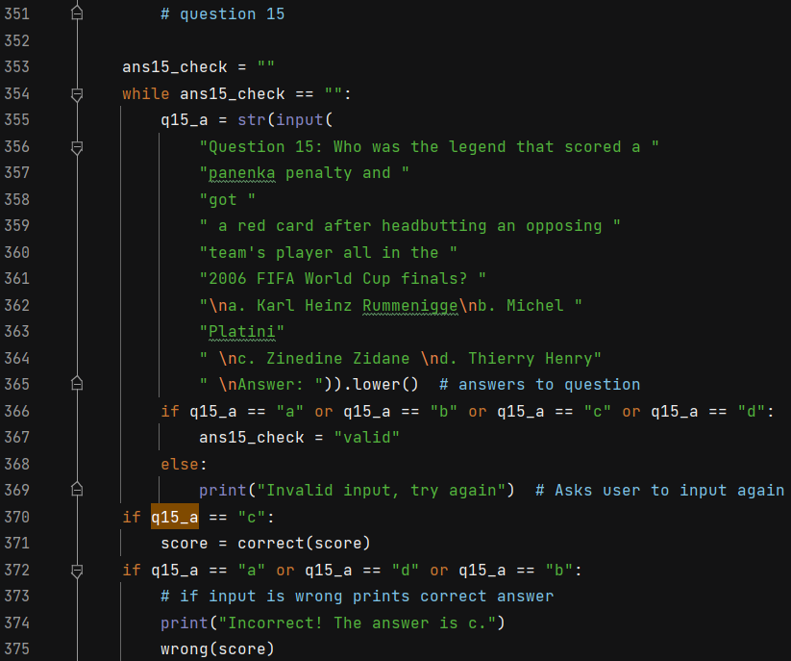
Decomposing outcome (question 15)
Line 353 - 355: a string to check the validity of user’s input, close of string at line 365. Line 356 - 365: prints the question and answers available for question 15 and allows the user to input their answer. Line 366 - 367: a check to show that if the user inputs: “a”, “b”, “c” or “d”, then that input is valid. Line 368 - 369: if the user inputs anything other than the 4 given options that is “a”, “b”, “c” or “d”, then their input is invalid and they will be asked to input again until their input is valid. Line 370 - 371: if the user inputted “c”, then their input is correct and the def “correct(score)” will function. Line 372 - 375: if the user inputted: “a”, “b” or “d” then their input is wrong. The message prints, showing that the correct answer is “c”. And then def “wrong(score)” functions.

Slide 22
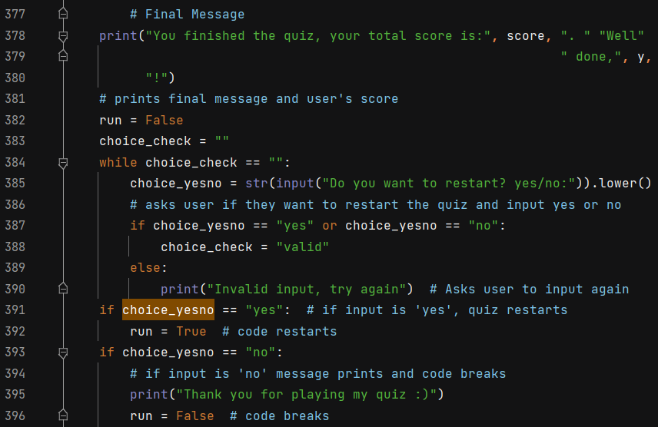
Decomposing outcome (final message)
This part codes for the final message after the user has finished the quiz. Line 378 - 380: prints a message that shows the user’s total score and thank them with their name “y”. Line 382: ends the quiz part of the code, starts the final message part. Line 383 - 385: a while string, asks the user if they want to restart the quiz or not? Gives them the option “yes” or “no” to input. Line 387 - 388: if the input is “yes” or “no” the input is valid. Line 389 - 390: if the input is anything but “yes” or “no”, then that input is invalid and the user is asked to input again. Line 391 - 392: if input is “yes”, run is true and the code restarts, this brings the code back to line 25, where i defined run = True and the code will continue again from that line, everything else will function the same. Line 393 - 396: if the input is “no”, a message prints to thank the user for playing the quiz. And run = False, which means the quiz will break and end.

Slide 23
Trialling components (playsound)
The ‘playsound’ component is one that allows imported sounds to be played throughout the pieces of code. In PyCharm there was a few versions of the playsound function but i decided to use the latest downloaded version due to it being the simplest to use as it only takes a few line of coding to function. I also went on a few free mp3 websites and decided for the correct sound, i chose a “ding!” noise. And for the wrong sound, i chose an intimidating 3 seconds noise as i think they both fit my quiz really well.

Slide 24
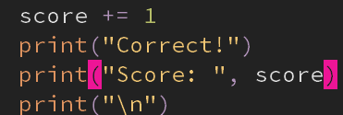
Trialling components - correct function
For the correct function of the code. I want it so that when the user gets a question correctly, they would gain a point and their score will show, a message would pop up to say that they answered correctly, a sound would play that sounds like a “ding!” and the next question would then be printed. I decided to use component 1 as it fits all of my criterias and it has tested to work. It also is a def, meaning that when i want to use it again, i would only have to type out “correct(score)”. I tested component 2 and it added the score, printed it, printed the message and then printed the next question. I did not use component two since it did not fit all of my criterias and it would require me to type it all out whenever i needed to use it. I tested both of them and decided to use component 1.
Component 1 (top)
Component 2 (bottom)

Slide 25
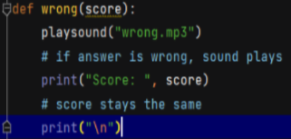
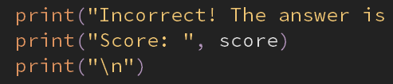
Trialling components wrong function
For the wrong function of the code. I want it so that when the user gets a question incorrectly, they would not gain a point and their score will show as the same, a message would pop up to say that they answered incorrectly, a sound would play that sounds like an intimidating sound and the next question would then be printed. I decided to use component 1 as it fits most of my criterias and it has tested to work. It also is a def, meaning that when i want to use it again, i would only have to type out “wrong(score)”. I tested component 2 and it printed the score as the same, printed the message and then printed the next question. I did not use component two since it doesn’t prints the sound, it also isn’t a def, meaning i would have to type it all down when i want to use it. I tested both of them and decided to use component 1.
Component 1 (above)
Component 2 (below)

Slide 26
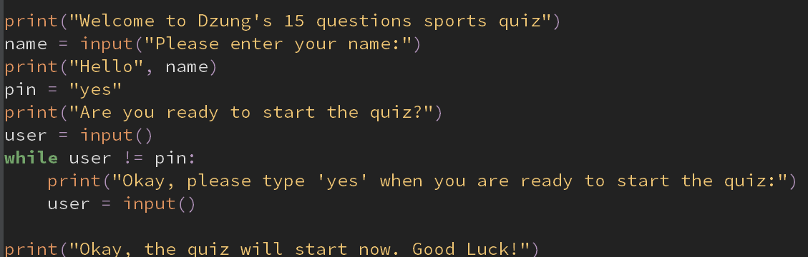
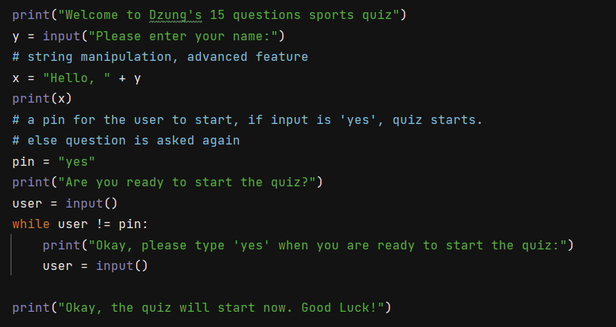
Trialling components welcome message
I want the welcome message to welcome the user, ask them to input their name, and ask them whether they want to start the quiz or not. For component one, it fulfills all of my criteria, however i did not use it. Instead i chose to use component 2 as it includes string manipulation which is an advanced feature. It also fits all of my criteria so i decided to use it due to it having more advanced features which helps my code overall. I tested both of them and decided to use component 2.
Component 1 (above)
Component 2 (below)

Slide 27
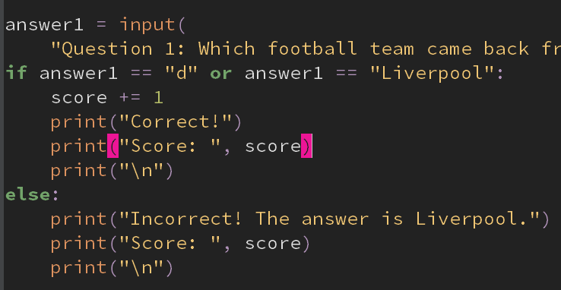
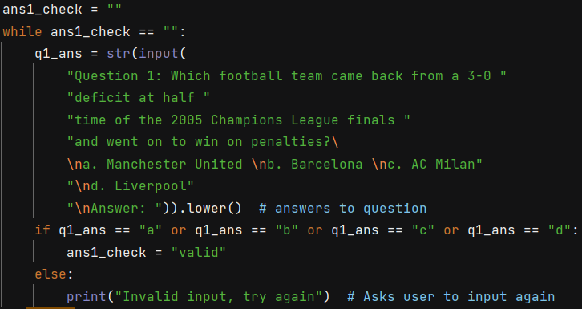
Trialling components input validity checker
For my validity checker for user’s input, i wanted it so that when the user inputs anything other than a, b, c and d, their input would be considered invalid and they would have to make another input. Therefore i chose to use component 2. Component two fulfilled all my criterias and it also included a message asking the user to input again. I did not use component one due to it not having an input validity checker. I tested both of them and decided to use component 2.
Component 1 (above)
Component 2 (below)

Slide 28

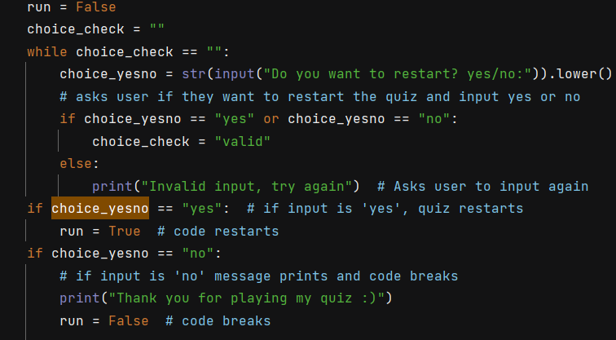
Trialling components end message
For my end message, i want it to thank the user for taking my quiz, show them the score they got and ask them if they want to restart the quiz. I decided to use component two as it fulfills all of my criterias. It also has an input validity checker and it also ask the user to input again if their input wasn’t valid. I did not use component 1 as it was too basic and didn’t fit my criterias. I tested both of them and decided to use component 2.
Component 1 (above)
Component 2 (below)

Slide 29
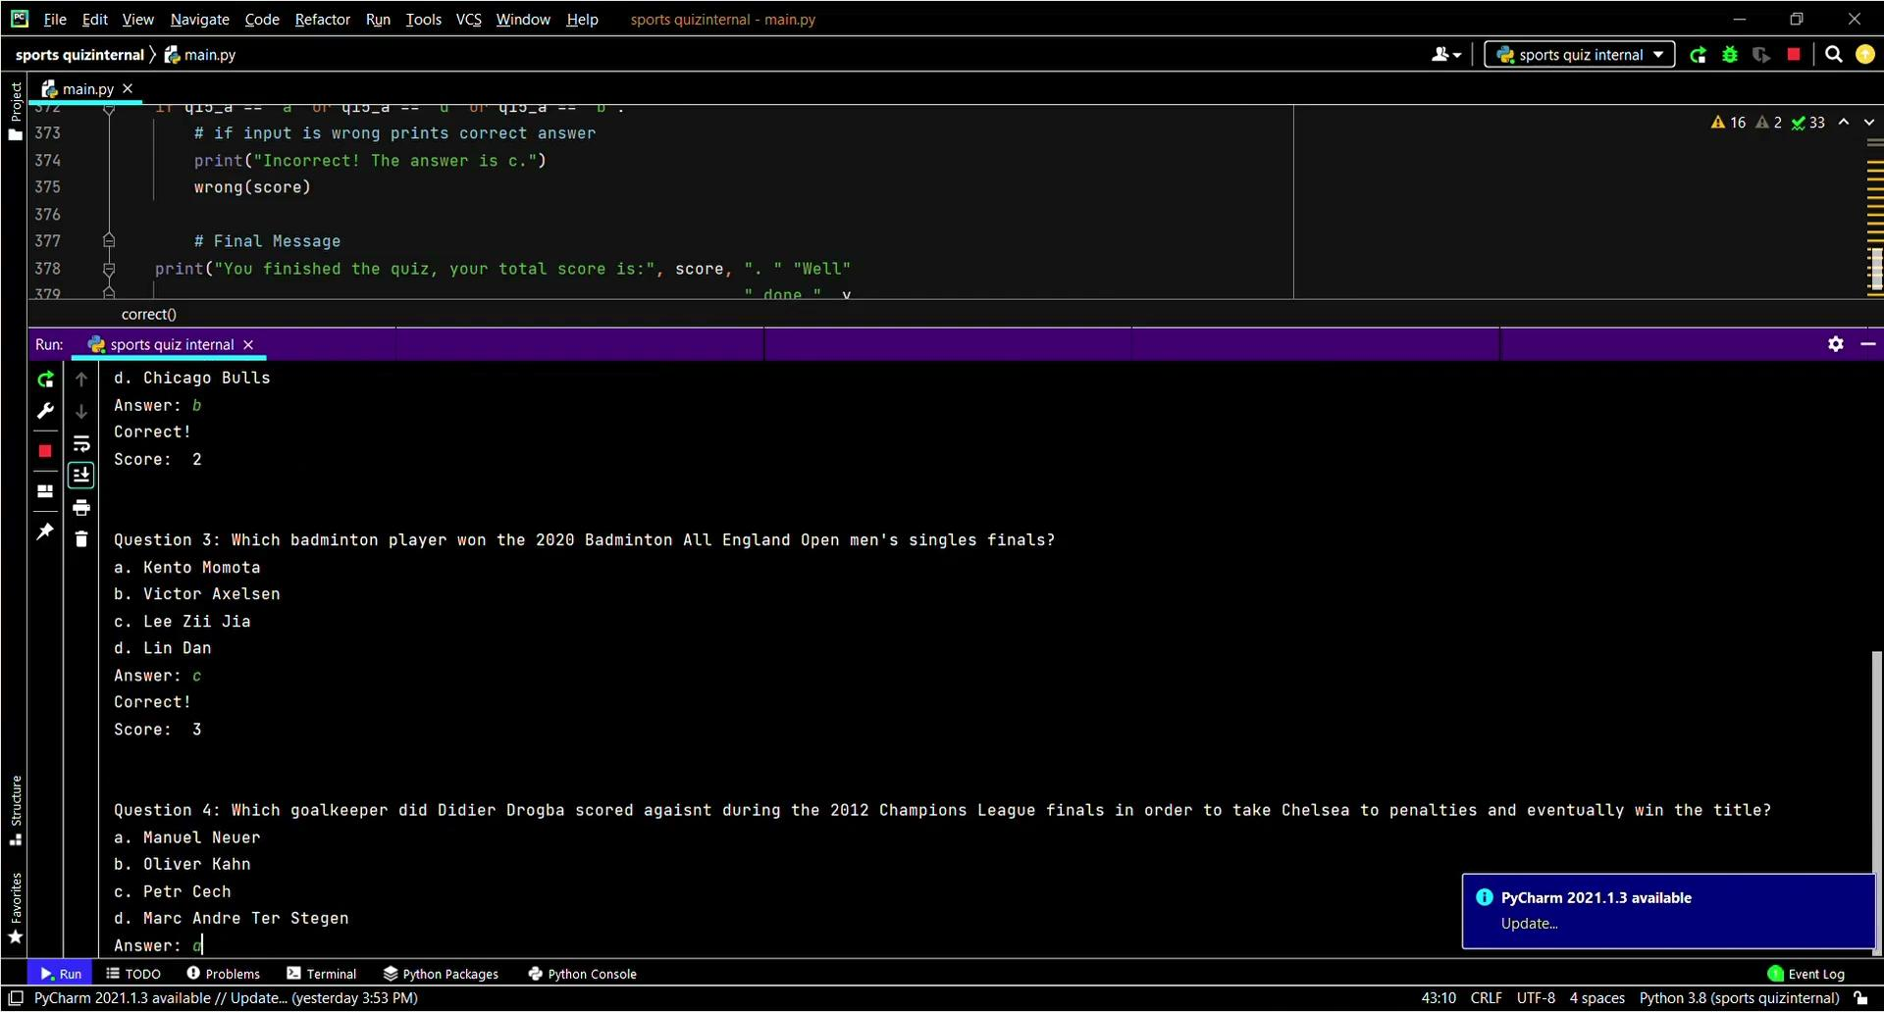
Testing outcome (PyCharm, all correct answers run)
https://drive.google.com/file/d/19MkfHL8wJX5KINAS4-aCZURfpOS5INnL/view?usp=sharing. Here is the Google Drive link to the video in case the video doesn’t work. In the video i have audio explanations of what i am doing in my test and what i am testing.

Slide 30

Testing outcome (PyCharm, all incorrect answers run)
https://drive.google.com/file/d/1rfpJRAuyTwe-VG5dUqqceMd1-S9xUis-/view?usp=sharing. Here is the Google Drive link to the video in case the video doesn’t work.
In the video i have audio explanations of what i am doing in my test and what i am testing.

Slide 31
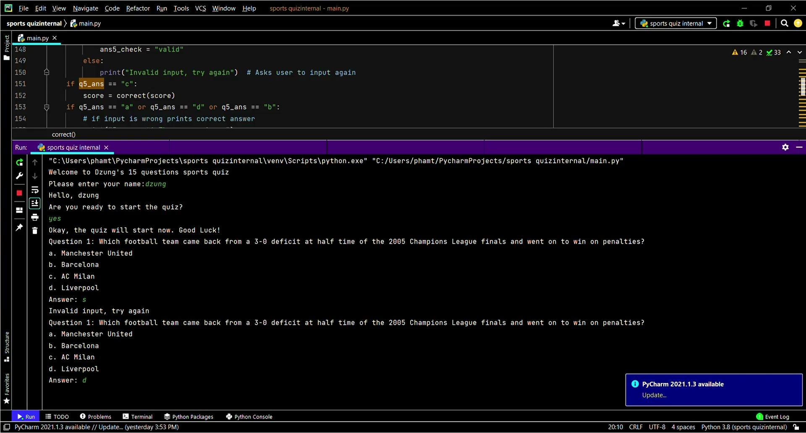
Testing outcome (PyCharm, invalid answers then valid answers check)
https://drive.google.com/file/d/1yfacqfmxH4GMTU0P0_yHwvxfcpVaAgLY/view?usp=sharing Here is the Google Drive link to the video in case the video doesn’t work. In the video i have audio explanations of what i am doing in my test and what i am testing.

Slide 32
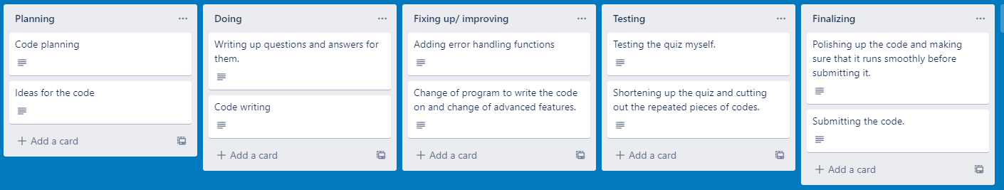
Project management: Applied
For my project management method, i used ‘work breakdown structure’ which is essentially breaking down the entire project into smaller, more manageable pieces and work on them slowly upto the entire project. This is shown in my project management tool as i divided the work up into smaller pieces and make cards out of them, i then work on each cards slowly. For the project itself, i did exactly what was said in my cards. Working on each thing slowly and one by one. I also divided all the components into smaller part as seen throughout my slideshow.
For the version control, i worked on MU Editor but due to it not supporting the features i wanted. I decided to switch to PyCharm which supported all of my features and it works better with my project management method of breaking down the work into smaller parts and work on them

Slide 33
Version Control (MU Editor test version)
https://drive.google.com/file/d/1-aBtRrWlyZO4lauGqnAQQWHpp13gmj_8/view?usp=sharing
Here is the Google Drive link to the video in case the video doesn’t work. In the video i have audio explanations of my version control. This video is the version control of MU Editor. An old version with little to no advanced features.

Slide 34
Version Control (PyCharm real version)
https://drive.google.com/file/d/1sPmKUAgEarQsNGH5HoJ-TDpIyB-D6Q8P/view?usp=sharing Here is the Google Drive link to the video in case the video doesn’t work. In the video i have audio explanations of my version control. This video is the version control of PyCharm. This is the refined version with many advanced features that i have added and submit as the final version.

Slide 35
Relevant Implications
For my relevant implications, i have: social, ethical, functionality and privacy.
Social: My project is revolved around sports and it doesn't offend or is inappropriate to anyone in anyways. It could also be a tool to teach people about sports knowledge that they may not have known about.
Ethical: My project does not include any violent content or any pornography of any kind.
Functionality: My project included error handling functions such as input validator to show whether the user’s input was valid or not. And if not, it then asks the user to input again.
Privacy: My project ensures that the user’s information such as their name is not stored in any ways, and that it would be deleted after the quiz ends, which is where the code breaks.

Slide 36
Evaluate
Overall i think i did a good job of planning out my project and working from my plan. My plan helped me work through my project with ease and it even helped me to not overcomplicate my project and help me not overload. Overall i am satisfied with the end product which is my quiz. After testing its functionality, i am satisfied with how every functions work as i intended them to. I then asked other people to test my code and they were overall satisfied with how user friendly and functional my quiz was. One thing i could improve with is my time management. Next time i would plan everything out a bit sooner to avoid any rushing or overloading work.

